Slide 1
NATURE OF CODE
By: Armaan Hooda (CS Club)

Slide 2
01
02
03
Introduction
Contents
Language
What is nature of code?
What will we study in this segment?
What language will we use?

Slide 3
What is nature of code?
Notes:
Integration of physics and computer science

Slide 4
Introductory topics
Vectors
Forces
Fractals
Oscillations
Perlin noise
Probability disctributions
Programming motion in nautral systems
Response to variety of enivronmental forces
Stimulating the geometry of nature
Calculate more complex forces in an environment
Notes:
Next up: Langauge

Slide 5

We will use …

Slide 6


Processing
p5.js
“Flexible software sketchbook”: Based on Java
JavaScript library for creative coding
Notes:
When to use the two
Download vs Website: https://editor.p5js.org/

Slide 7
How to download Processing?
Go to the website
Click on Download
Download .exe file
https://processing.org/
Choose suitable download file
Download the exe.file

Slide 8
Perlin noise
Type of gradient noise, used in visual effects and graphics and procedural textures (video games, movies, etc.)

Slide 9
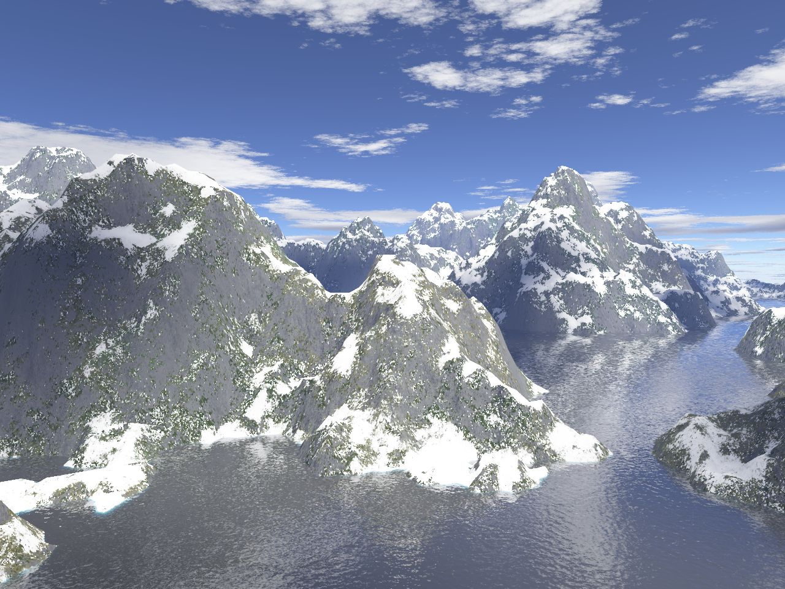
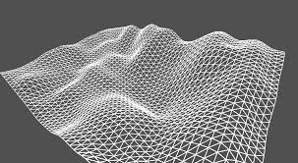
Some cool graphics made using Perlin noise

Slide 10
Randomness is not always random

Slide 11
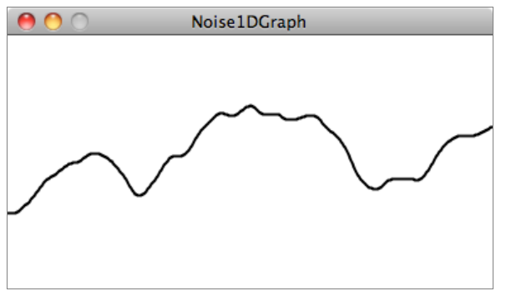
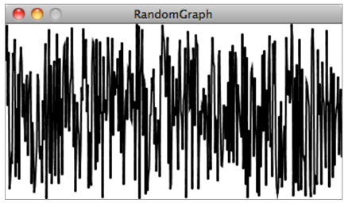
Randomness: Built-in methods: noise() vs random()
Notes:
random(min, max) – clear arguments
noise() >>> always gives a value between 0, 1

Slide 12
Let’s get coding…

